Slide 1
Faculty Database Management System
Information System Project

Slide 2
Project Description
Project is applied to a faculty to manage its database
We Used Data of faculty of computers and Information as an Example for our Database System
Project consists of 7 Tables, 2 Queries , 1 Main form and 3 Forms

Slide 3
Using Data of :
Students
Instructors
Employees
Sectors, Units and Labs

Slide 4
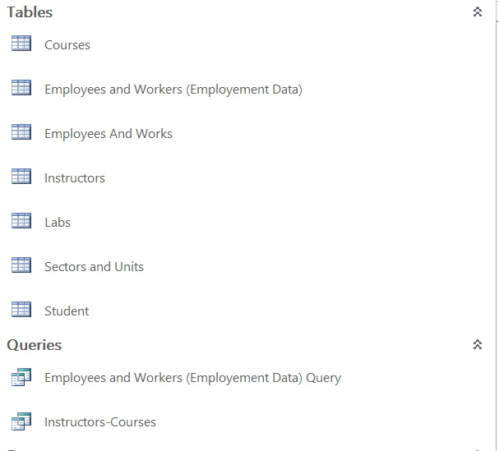
Tables and Queries

Slide 5
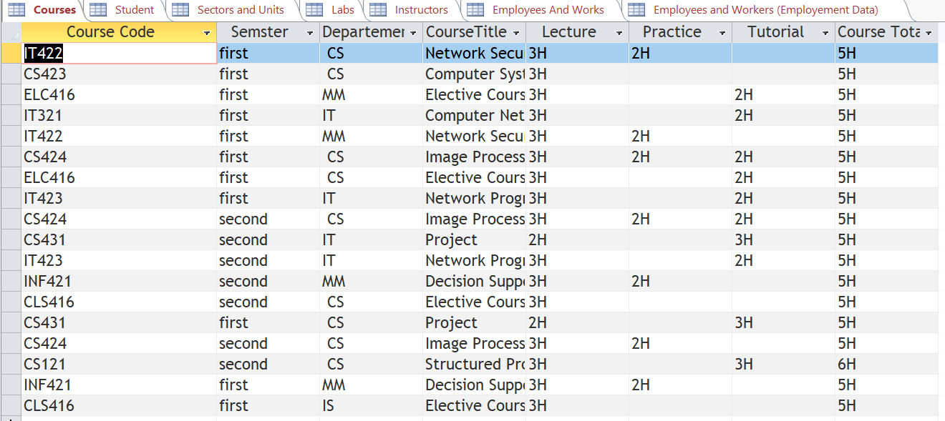

Slide 6
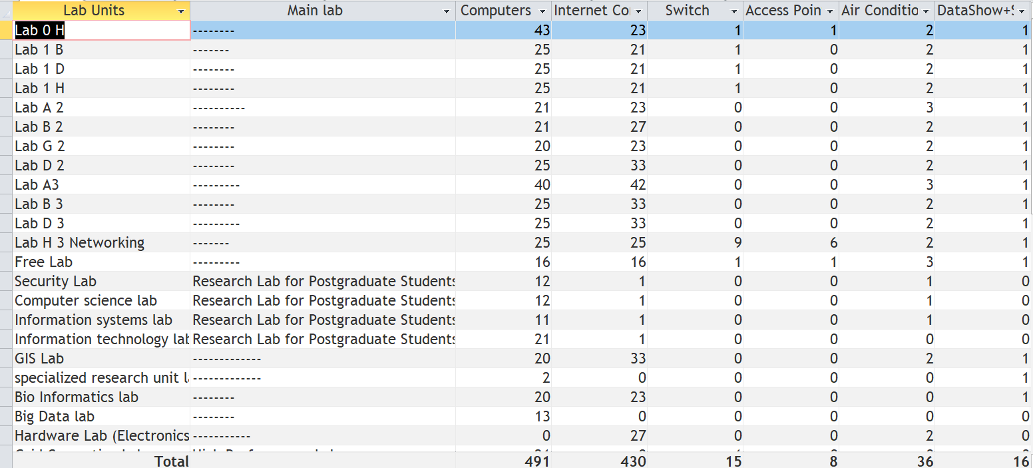

Slide 7
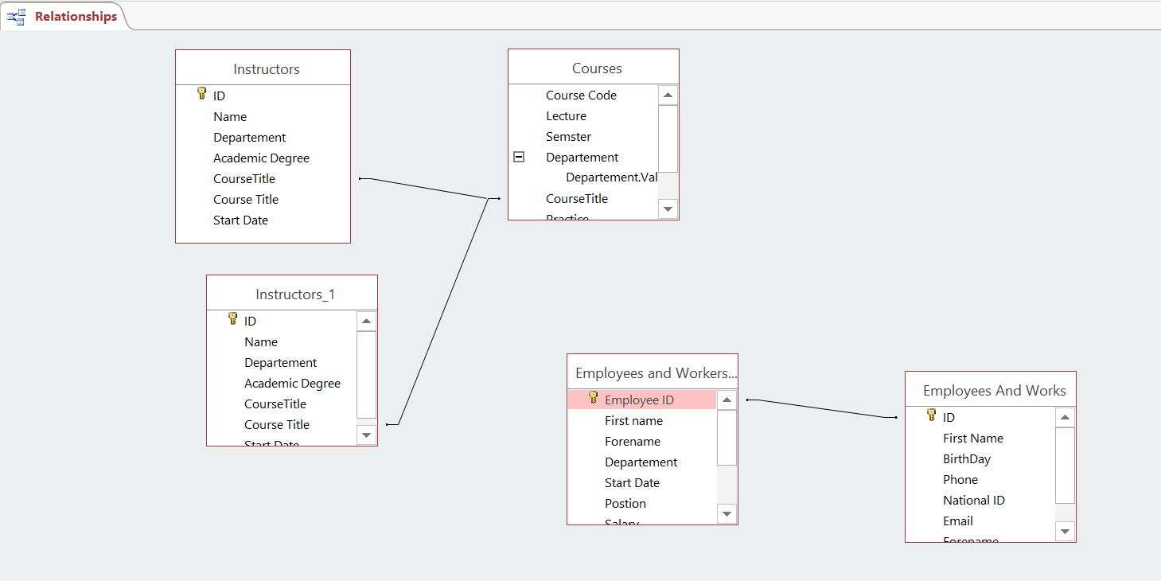
Relations

Slide 8
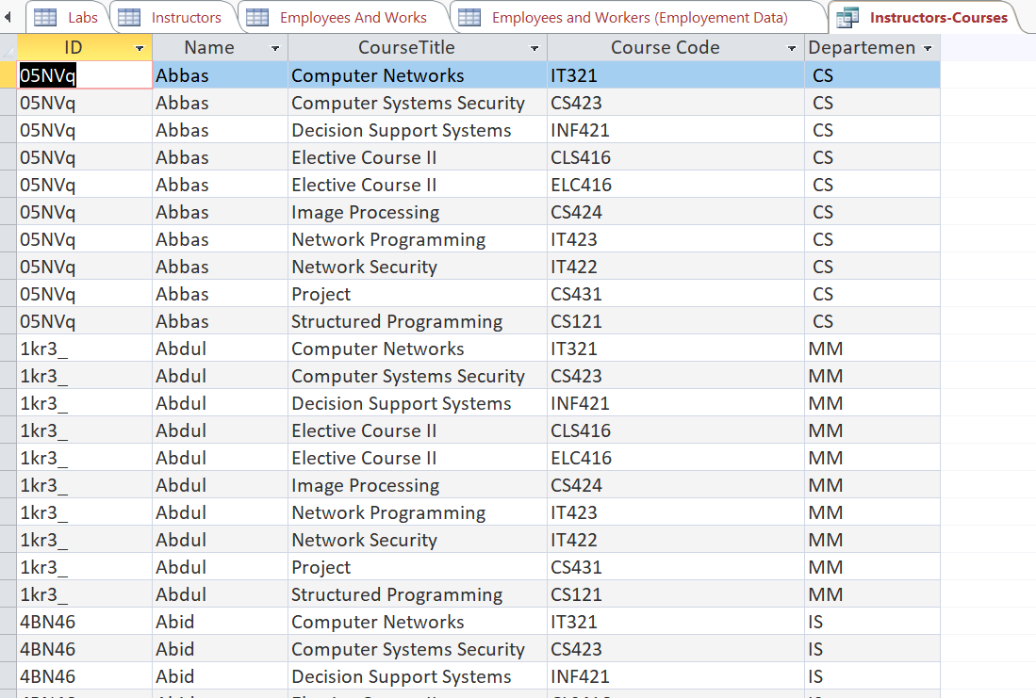
Instructors-Courses Query

Slide 9
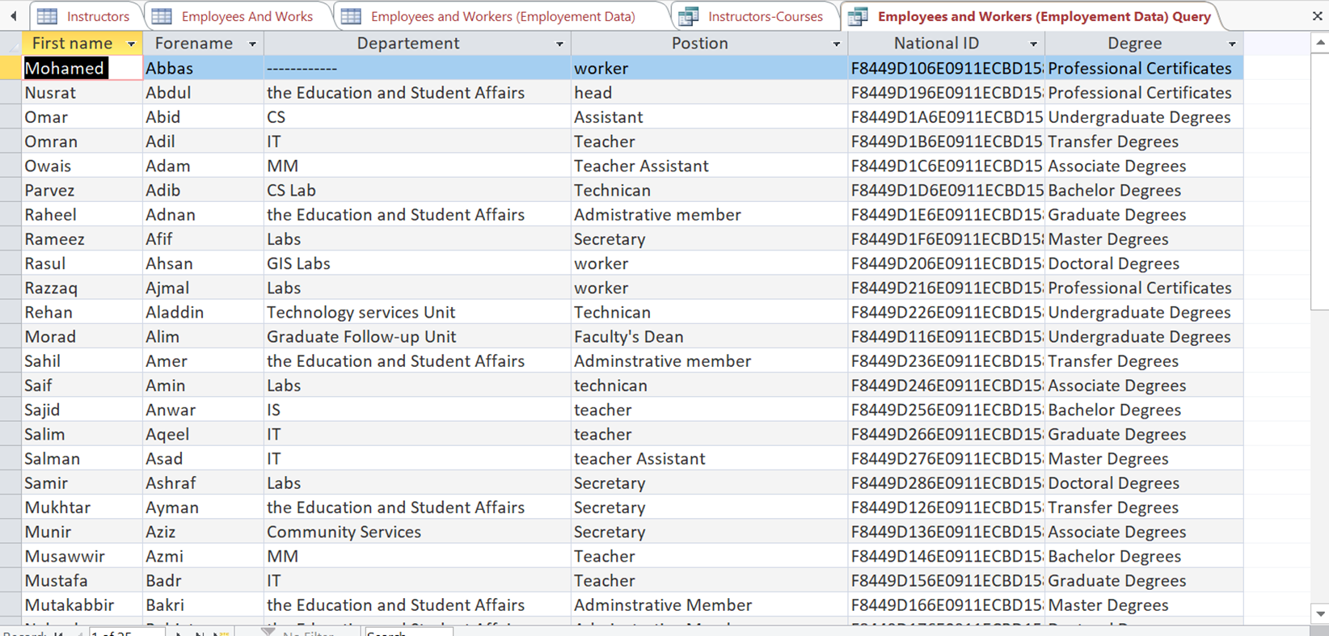
Employees Query

Slide 10
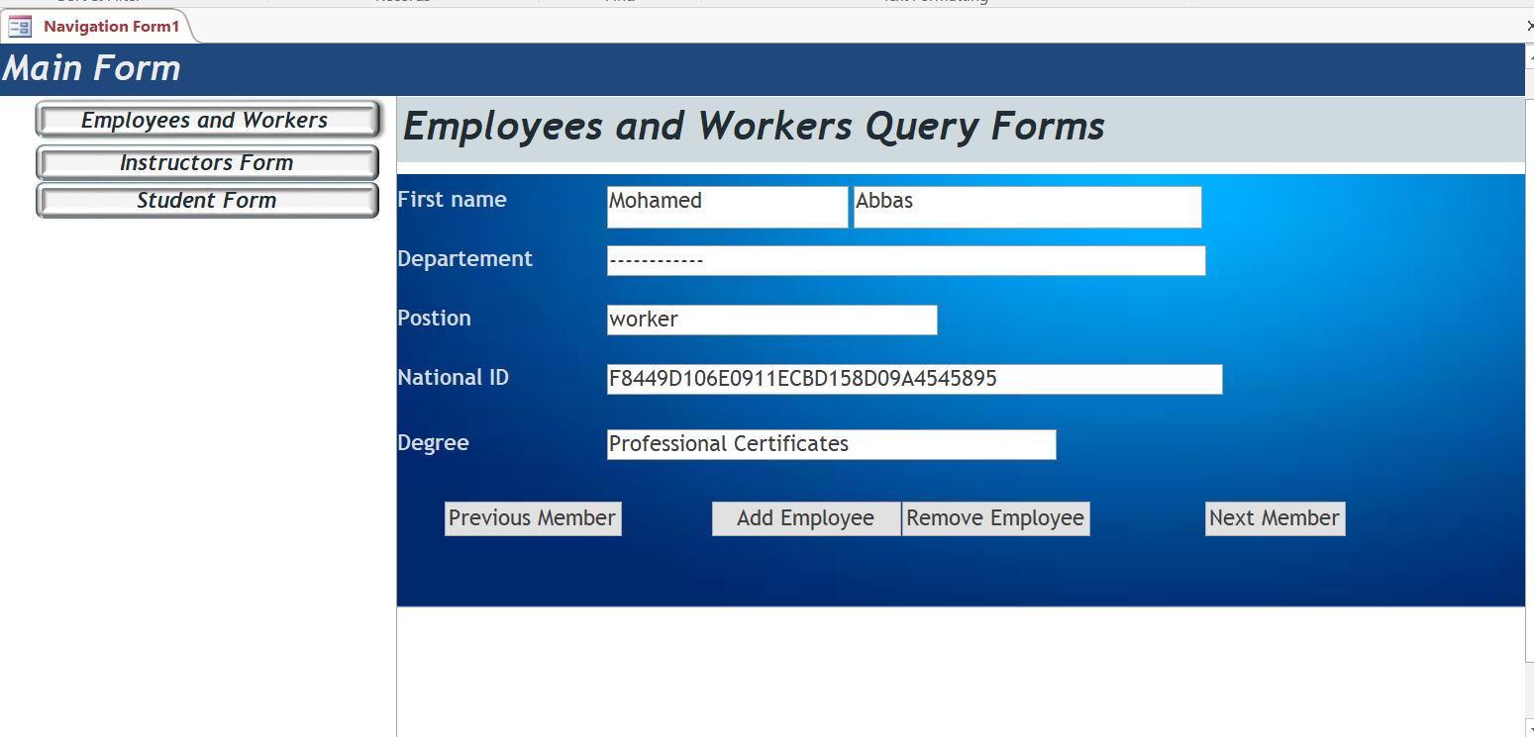
Main Form

Slide 11
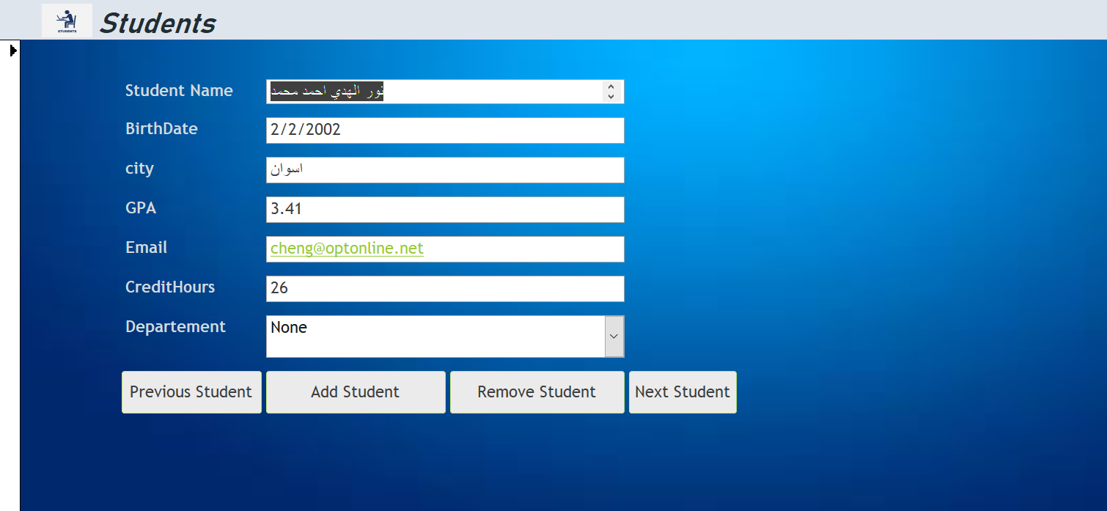
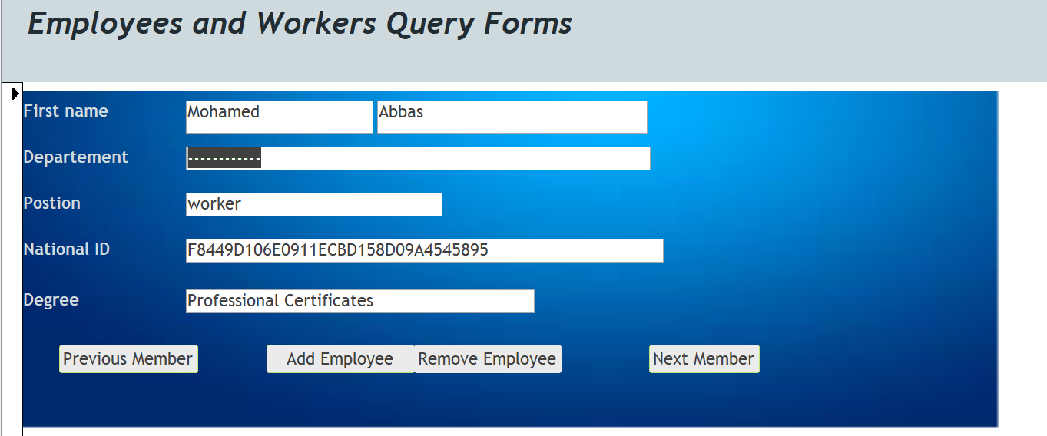
Forms

Slide 12
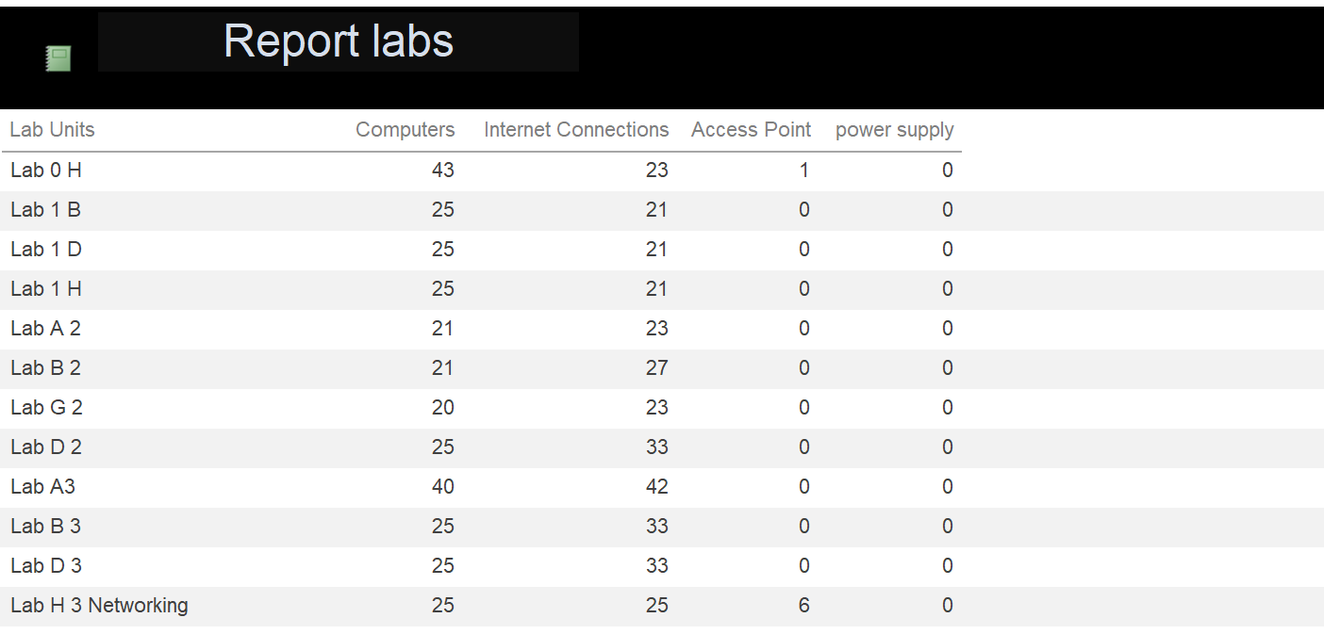
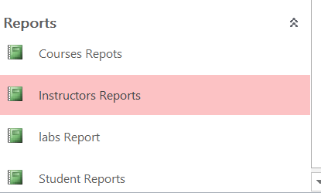
Reports

Slide 13

Protecting Database

